Slide 1
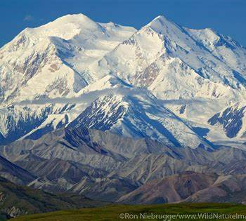
INTRODUCTION TO THE PLACEMENT SEARCH AND SUPPORT UNIT (PSSU)
The Office of Children’s Services is continuing to create its Placement Search and Support Unit.
This continues to be a long process with many hold ups stemming from the allocation/re-allocation of positions. However, we have many of the positions filled as of 8/17/23.

Slide 2
UNIT ORGANIZATION
This unit will be managed by Social Services Program Officer, Linda Clapp-Damerow and supervised by Social Services Program Coordinator (SSPC) Diana Mullen who will supervise a team of 6 Social Services Associates for the PSSU.
SSA team members will be located throughout the state and will provide customer service/support for resource families and conduct placement searches for all regions. For example, if you are a caregiver who lives in Juneau, and you call or e-mail the PSSU, any member of the PSSU team will be able to assist you.
Currently, the plan is to have unit members rotate through an evening (approx. 8:00 pm) shift to assist with on-call placement needs and to provide extended hours of support for Resource Families.

Slide 3
Vision
The Vision for this unit is to streamline the placement search process and provide robust and timely customer service and support for Resource Families.

Slide 4
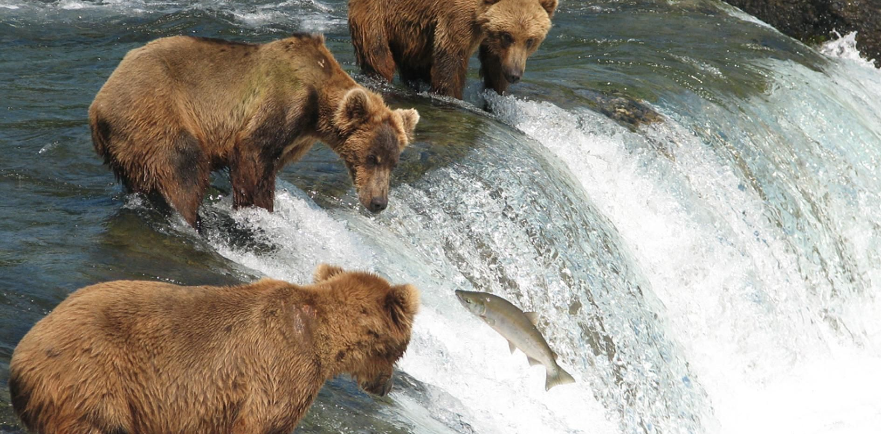
Mission
To develop a high-functioning unit whose goals are to:
Find preferential placements.
Increase placement stability by finding placements that are a good fit for children and resource families.
Provide robust support and timely responses to caregivers.

Slide 5
How will this unit support Resource Family’s?
Timely responses to phone calls and e-mails.
Provision of documents, forms and other paperwork.
Answering a variety of questions. If we don’t have the answer, we will find it. If it’s a question we can’t answer we will facilitate contact with the person who can provide an answer.
Linking Resource Families with service providers and community resources who can assist them in meeting the needs of children in their care.
Facilitating the processing of requests for commodities by having this unit cross-train with the Special Needs Hotline team.
Assisting Resource Families in addressing concerns surrounding foster care payments by brokering conversations with OCS’s Provider Payments Unit.
Streamlining communication about placement of children to eliminate multiple phone calls to the same providers on the same day asking if they can take placement of a child when they have already said they are unable to.
Providing as much information as possible to help Resource Families determine if they can meet the needs of a child and if that child would be a good “fit” with their family.
Conducting Augmented Rate assessments.
This is a preliminary list of some ways this unit will support Resource Families and this list will evolve over time.

Slide 6
FAQ’s
Q: Is this the unit I should call if I want a child removed from my home?
A: No- you will need to contact the primary PSS. If it’s after hours, you will need to call OCS’ Intake Department.
Q: Will members of this unit transport children to/from placement, visits, appointments, etc.?
A: No, this unit does not transport.
Q: Is this the unit I call if a child in my care needs clothing or other items?
A: Both the PSSU and the Special Needs Hotline are managed and supervised by Linda Clapp-Damerow and Diana Mullen. Both units will be cross-trained on each other’s job duties. As such, these two units will work together to assist you in obtaining qualifying commodities for children in your care.
Q: If I call the Special Needs Hotline and leave a message but they don’t call me back should I then call the PSSU?
A: No, please don’t do this. If you’ve left a message for the Special Needs Hotline and haven’t had a phone call back OR an e-mail from them w/in 72 working hours please e-mail them at fcs.ocs.special.needs.hotline@alaska.gov.
Q: How will I contact the PSSU?
By e-mail: fcs.ocs.pssu@alaska.gov
By phone: 1-855-603-8637
.

Slide 7
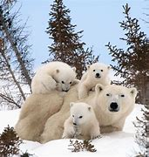
Questions/Ideas
What questions or ideas do you have?
If you come up with any questions or ideas after this meeting, please e-mail Diana Mullen at diana.mullen@alaska.gov with a cc to Linda Clapp-Damerow at linda.clapp-Damerow@alaska.gov

Slide 8
Thank you all for caring for Alaska’s children!

