Slide 1
Becoming INDEPENDENT
Managing Healthcare Needs As An Adult

Slide 2
Adolescent Transition
Time of Preparation
Develop Skills and Knowledge
Process Rather Than One Time Event
Involves Adolescent, Family, and Providers
Notes:
Teach toddlers how to feed and dress themselves, to walk and talk.
School age children learn how to read, social skills, and play with others.
For most adolescents when we talk about transition we often focus on school and work and maybe transportation because being able to get to the places you want to get to is also important.
Time to build on skills learnt earlier in life.
Prepare for moving from Pediatric to Adult Care
Develop Skills and Knowledge to Manage Adult Healthcare needs as an adult.

Slide 3
adolescence
Exciting And Challenging Time
Learn Responsibility
Build on Past
Prepare for the Future
Set Realistic Expectations
Notes:
Need practice making decisions, in order to learn the skill of how to make good decisions.

Slide 4
School expectations
Identify Interests and Goals
Individual Education Plan or 504 Plan
Attend Classes
Complete Assigned Work
Graduate
Notes:
Similarly when we think about the teenage years we think about school expectations.
School is often seen as the foundation for where a teen will go next. It’s an opportunity to identify what interests teenagers have, what they enjoy doing, and figuring out what they might like to do in terms of getting a job or attending college to get specific qualifications.

Slide 5
Health expectations
Physical – Health of the Body
Emotional – Feelings
Mental – Thoughts
Spiritual – Beliefs and Values
Relationships – With Yourself and Others
Notes:
So how does your health fit into the transition process.
In order to be able to go to school or work, visit friends, complete goals you set for yourself, you need to feel well enough to do be able to participate in these types of activities.
Being healthy involves all aspects of who you are.

Slide 6
Decision making
A Learned Skill
Opportunity to Practice
Support to Gain Confidence
Develop Capacity
Notes:
Everyone needs opportunities and support to learn how to make good decisions.
Lack of opportunity to make decisions can prevent people from developing capacity.
Transition is an opportunity to teach adolescents how to make healthy choices, which hopefully will help them to grow up to be healthy adults.

Slide 7
provider questions

Slide 8
Developing skills

Slide 9
Managing health care
Make Doctor’s Appointments
Refill Medications
Ask Doctor/ Medical Provider Questions
Notes:
Many learning to manage healthcare videos are available at Healthy Transitions. Moving From Pediatric to Adult Health Care. New York State Institute for Health Transition Training for Youth with Developmental Disabilities. https://healthytransitionsny.org/videos/

Slide 10
Ask me 3
What is my Main Problem
What Do I Need to Do?
Why Is It Important For Me To Do This?

Slide 11
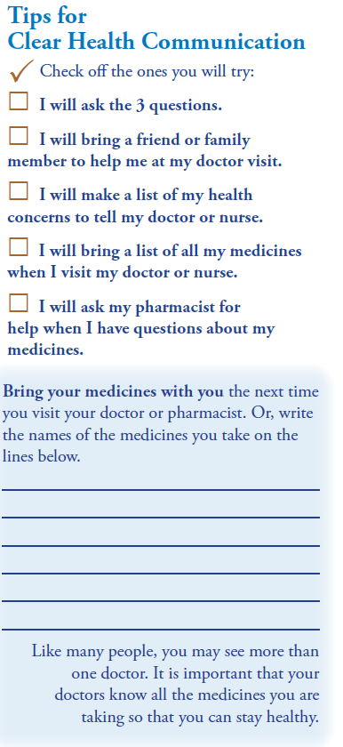
Ask me 3
Notes:
Back of Handout – this is a good form to take with you the next time you see a health care provider, such a doctor, nurse, or pharmacist, and ask them the three questions to help you understand your medical needs better.
Source: Ask Me 3. Indian Health Service. Healthy Literacy. Ask Me 3. https://www.ihs.gov/healthcommunications/includes/themes/responsive2017/display_objects/documents/AskMe_8-pg_NatAmer.pdf
This tool can also help with reading back to a provider answers to questions, to make sure that what you heard was what the provider meant. Being able to understand what your medical needs are, gives you the information you need to decide how best to take care of yourself.

Slide 12
Monitor Progress

Slide 13
checklists
Set Goals
Learning Plan
Identify Resources
Share Successes and Struggles

Slide 14
checklists
Notes:
Checklists also allow adolescents, parents and caregivers to share information with multiple providers in different settings. Skills being learnt in the medical setting can be shared at school and can help ensure medical needs are attended to during the school day.

Slide 15
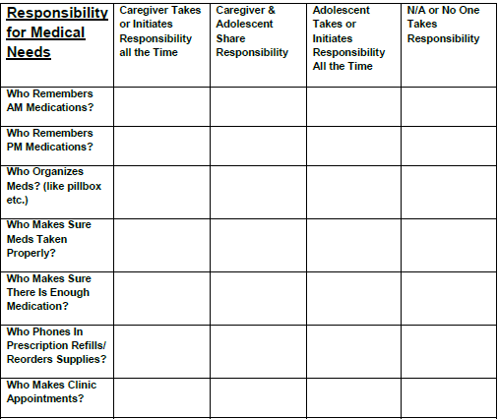
Shared responsibility
Notes:
Care Agreements and Shared Responsibility Charts help encourage adolescents to participate in decision-making and can help adolescents learn how to take responsibility within a supportive environment, where even if mistakes are made, the support of caregivers can help adolescents learn from mistakes.

Slide 16
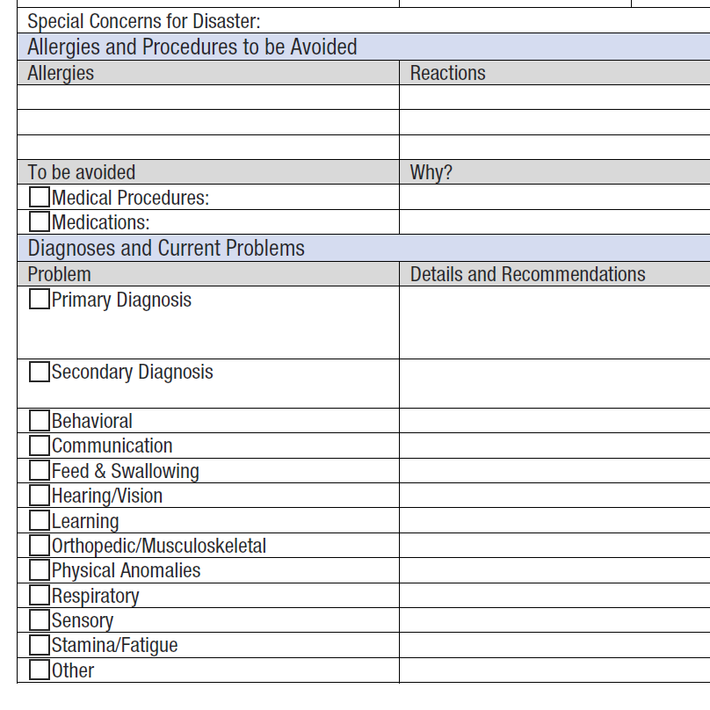
Daily and emergency plans

Slide 17
Future topics
Access To Care
Health Insurance
Consent for Treatment
Confidentiality

Slide 18
QUESTIONS
Notes:
Summarise the presentation.
HANDOUTS:
Care Plan and Emergency Contact Information – discuss completing with a parent/ caregiver and also discussing at the next appointment with pediatrician/ primary care provider.
Transition Readiness sheets for Young Adult and Parents – have young adult and parent discuss and think about completing to assess where they both are with the young adult learning health care management skills.
Health Insurance sheet – discuss the homework assignment.
Both the transition readiness sheets and health insurance questions will be discussed in a couple of days.

Slide 19
Contact information
Joanne Singleton, LCSW, MPH,
Public Health Specialist II,
Women’s, Children’s & Family Health,
Alaska Division of Public Health,
Phone: (907) 269-3430
Fax: (907) 754 3425
joanne.singleton@alaska.gov

